Slide 1
3.5 Non-Newtonian fluids
Newtonian fluids are fluids which follow Newton’s law:
Shear Stress
Shear Rate
CHE315
3.5 Non-Newtonian fluids

Slide 2
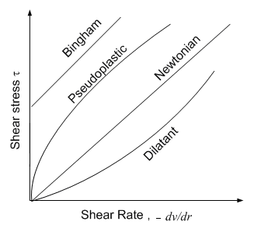
Non-Newtonian fluids do not follow Newtonian law.
Therefore, For non-Newtonian fluids, the plot of the shear stress vs. shear rate is not linear through the origin.
Shear Stress
Shear Rate
CHE315
3.5 Non-Newtonian fluids

Slide 3
1. Bingham fluids
Linear BUT does not go through the origin.
A finite shear stress (yield stress) is needed to initiate flow.
Examples :tooth paste, soap and chocolate mixtures.
CHE315
3.5 Non-Newtonian fluids

Slide 4
2. Pseudoplastic fluids.
Most non-Newtonian fluids are Pseudoplastic such as polymer melts, mayonnaise
Their apparent viscosities decrease with increasing shear rate.
Represented by a power-law eq.:
K: consistency index And n: flow behavior index
CHE315
3.5 Non-Newtonian fluids

Slide 5
3. Dilatant fluids.
Less common than pseudoplastic fluids. Examples are starch in water.
Their apparent viscosities increase with increasing shear rate.
CHE315
3.5 Non-Newtonian fluids

Slide 6
Group Study
CHE315
3.5 Non-Newtonian fluids
Hint Questions:
Which mathematical model can represent each type of fluids
What is the relation between shear rate and viscosity for each type? Compare with Newtonian fluids.
Can you write one general model for all types of fluids ? Try!!
What is the value of n for each type of fluids?
Task:
Study with your group the following:
Bingham Fluids
Pseudoplastic Fluids
Dilatant Fluids

Slide 7
Viscosity of Non-Newtonian
Q.: What is shear thinning and shear thickening?
CHE315

Slide 8
the generalized Reynolds number is defined as:
=
Quiz: What if n = 1?
CHE315

Slide 9
Laminar Flow of Power Law Fluid
Hagen – Poiseuille Eq.:
Power Law Model:
Newton’s Law:
Combined
CHE315

Slide 10
CHE315

Slide 11
Quiz: What if n = 1?
CHE315

Slide 12
3. Friction factor method
An alternative way of calculating the pressure drop due to friction is to use the Fanning factor method, as in section 2.10 for Newtonian fluids, but using the generalized Reynolds number:
CHE315

Slide 13
For Newtonian fluids: α = ½ for laminar flow.
For power-law non-Newtonian fluids:
CHE315

Slide 14
Losses in contractions and fittings
Losses in sudden expansion
CHE315

Slide 15
Turbulent flow and generalized friction factors
In turbulent flow of time independent fluids the Reynolds number at which turbulent flow occurs varies with the flow properties of the non-Newtonian fluid.
In figure 3.5-3, for different values of n’, the fanning friction factor f is plotted versus the generalized Reynolds number for non-Newtonian fluids flowing through a smooth, round tubes.
Describe the figure 3.5-3 and see example 3.5-2
CHE315

Slide 16
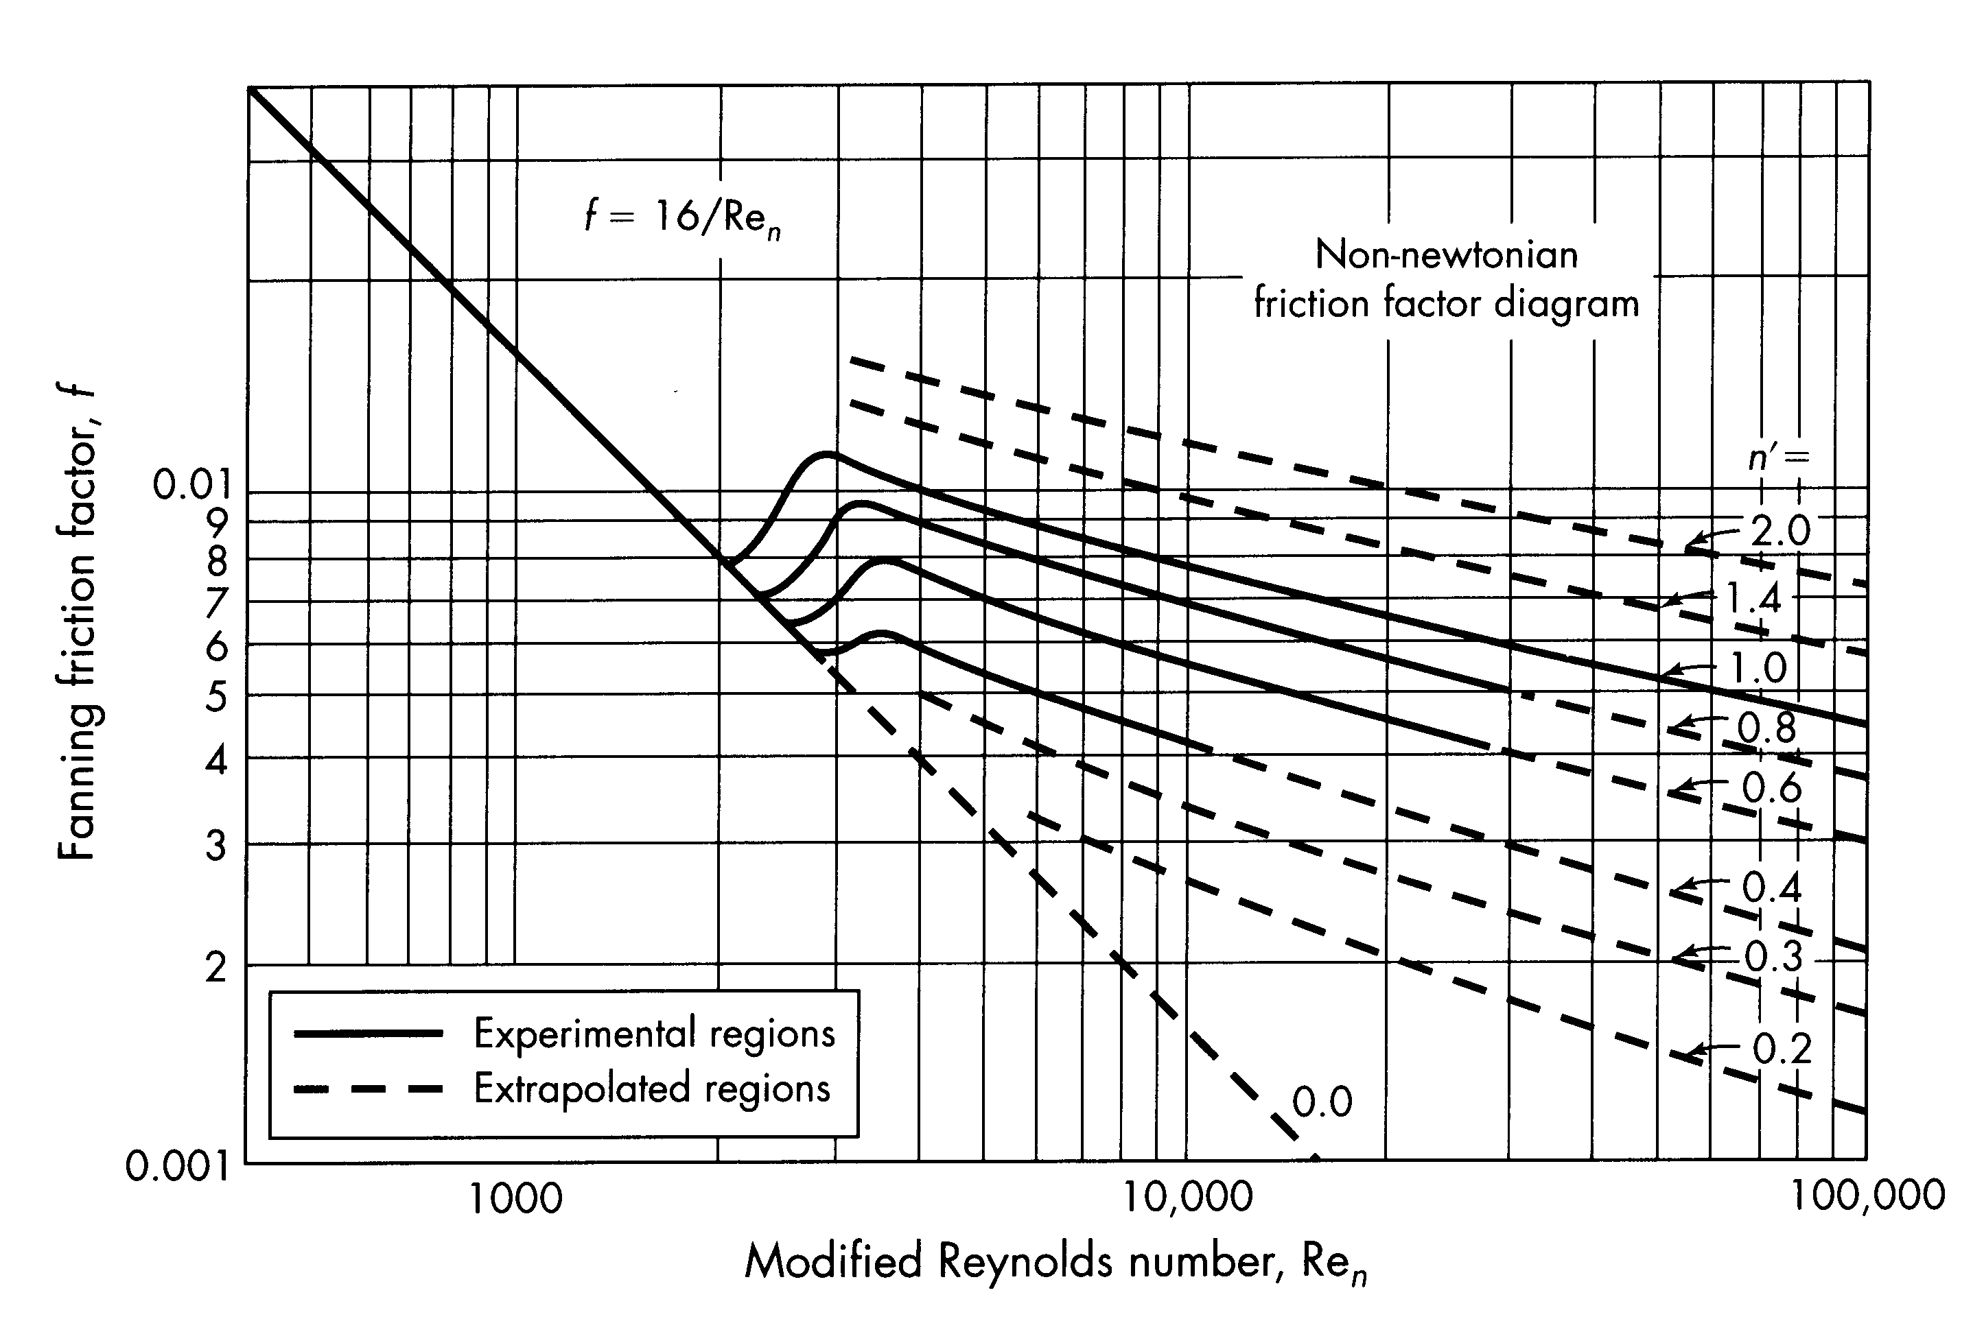
CHE315

Slide 17
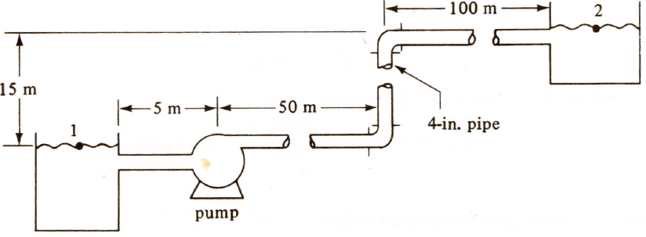
Example:
A chemical solution (density =960 kg/m³) is being pumped at the rate of 5e-3 m³/s. pump efficiency is 65%. The pipes are schedule 40. The solution is a power law fluid with power law index being 0.8 and consistency index being 0.5 pa.s^{n}. Calculate the power needed for the pump. (Hint: See example 2.11.7)
CHE315

Slide 18
Flow in Packed Beds
v’ = εv
Pressure Drop in Packed Bed
Laminar Flow:
Blake-Kozeny Eq.
Turbulent Flow:
Burke-Plummer Eq.
CHE315

Slide 19
General Equation
Ergun Eq.
CHE315

